Slide 1


MODFLOW 6 Groundwater Flow Model
47TH IAH Congress
São Paulo, Brazil
August 22, 2021
Notes:
Describe some of the ongoing work we are doing with MODFLOW
MODFLOW and related software distributed by the USGS is developed and supported by a growing team of USGS scientists and external collaborators. Recent MODFLOW development efforts have focused on use of unstructured and locally refined grids for constant or variable-density groundwater flow and solute transport simulation, robust handling of three-dimensional anisotropy, generalization and tracking of water transfer between packages, distributed memory parallelization, and consolidation of these core capabilities into MODFLOW 6. These capabilities make it possible to construct new types of models, such as tightly coupled nested models, that have not been possible with previous MODFLOW versions. Underlying these efforts has been the adoption of an open-development philosophy that relies on testing-based development and continuous integration practices by the core development team and by the broader MODFLOW community. Ongoing development increasingly relies on the Flopy python package for automating model construction. Resulting from these development efforts is a suite of MODFLOW programs that can be applied at local, regional, and National scales for a wide variety of complex groundwater flow and transport problems.
OASIS MCT

Slide 2
MODFLOW 6 Framework

Slide 3
MODFLOW Framework Components
MODFLOW-2005
MODFLOW 6

Slide 4
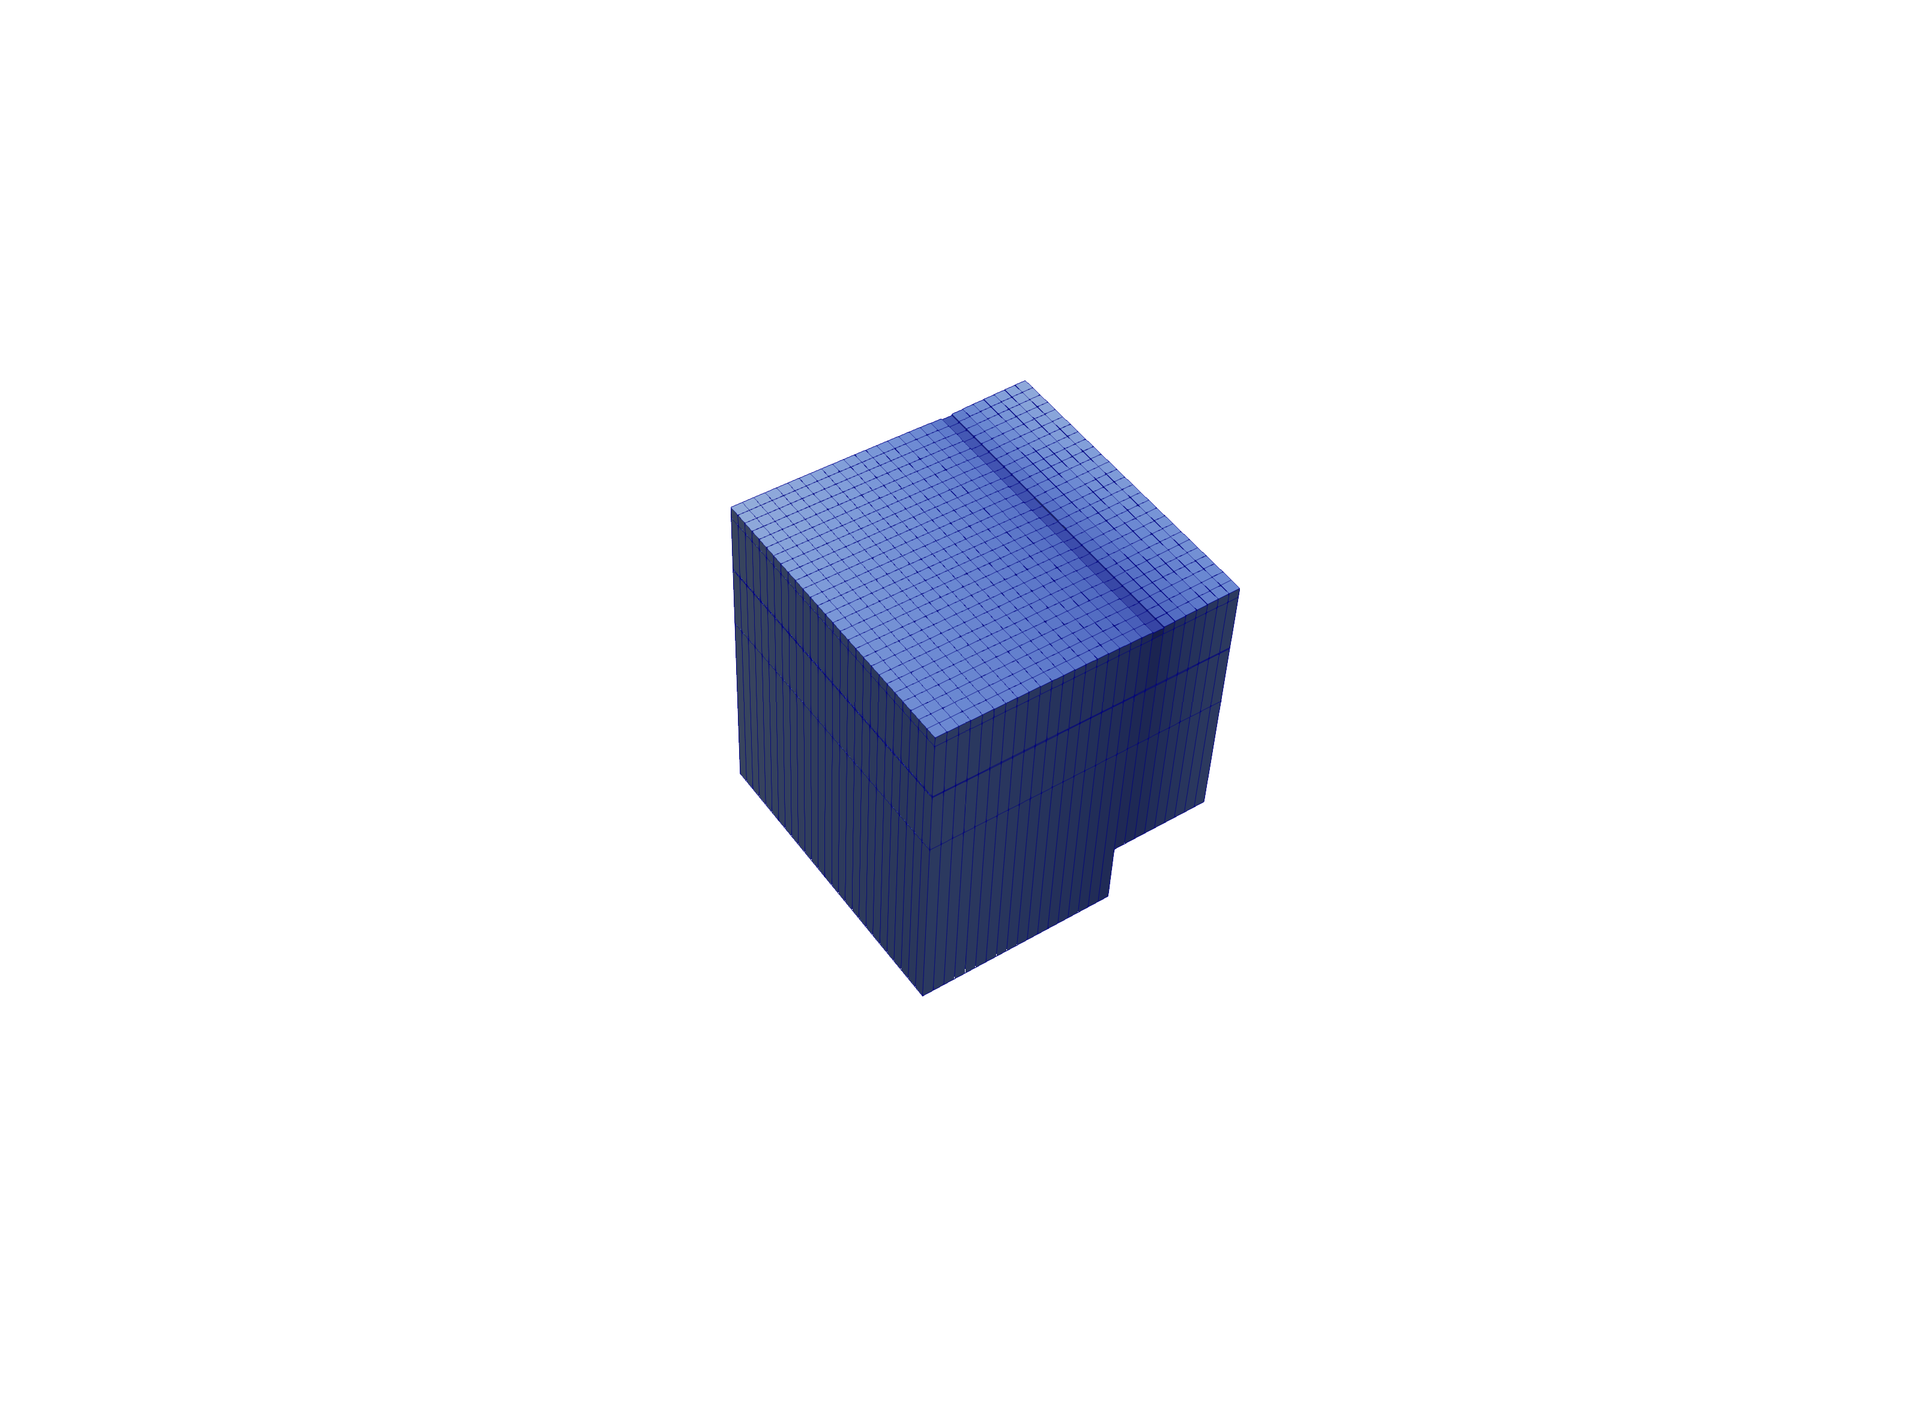
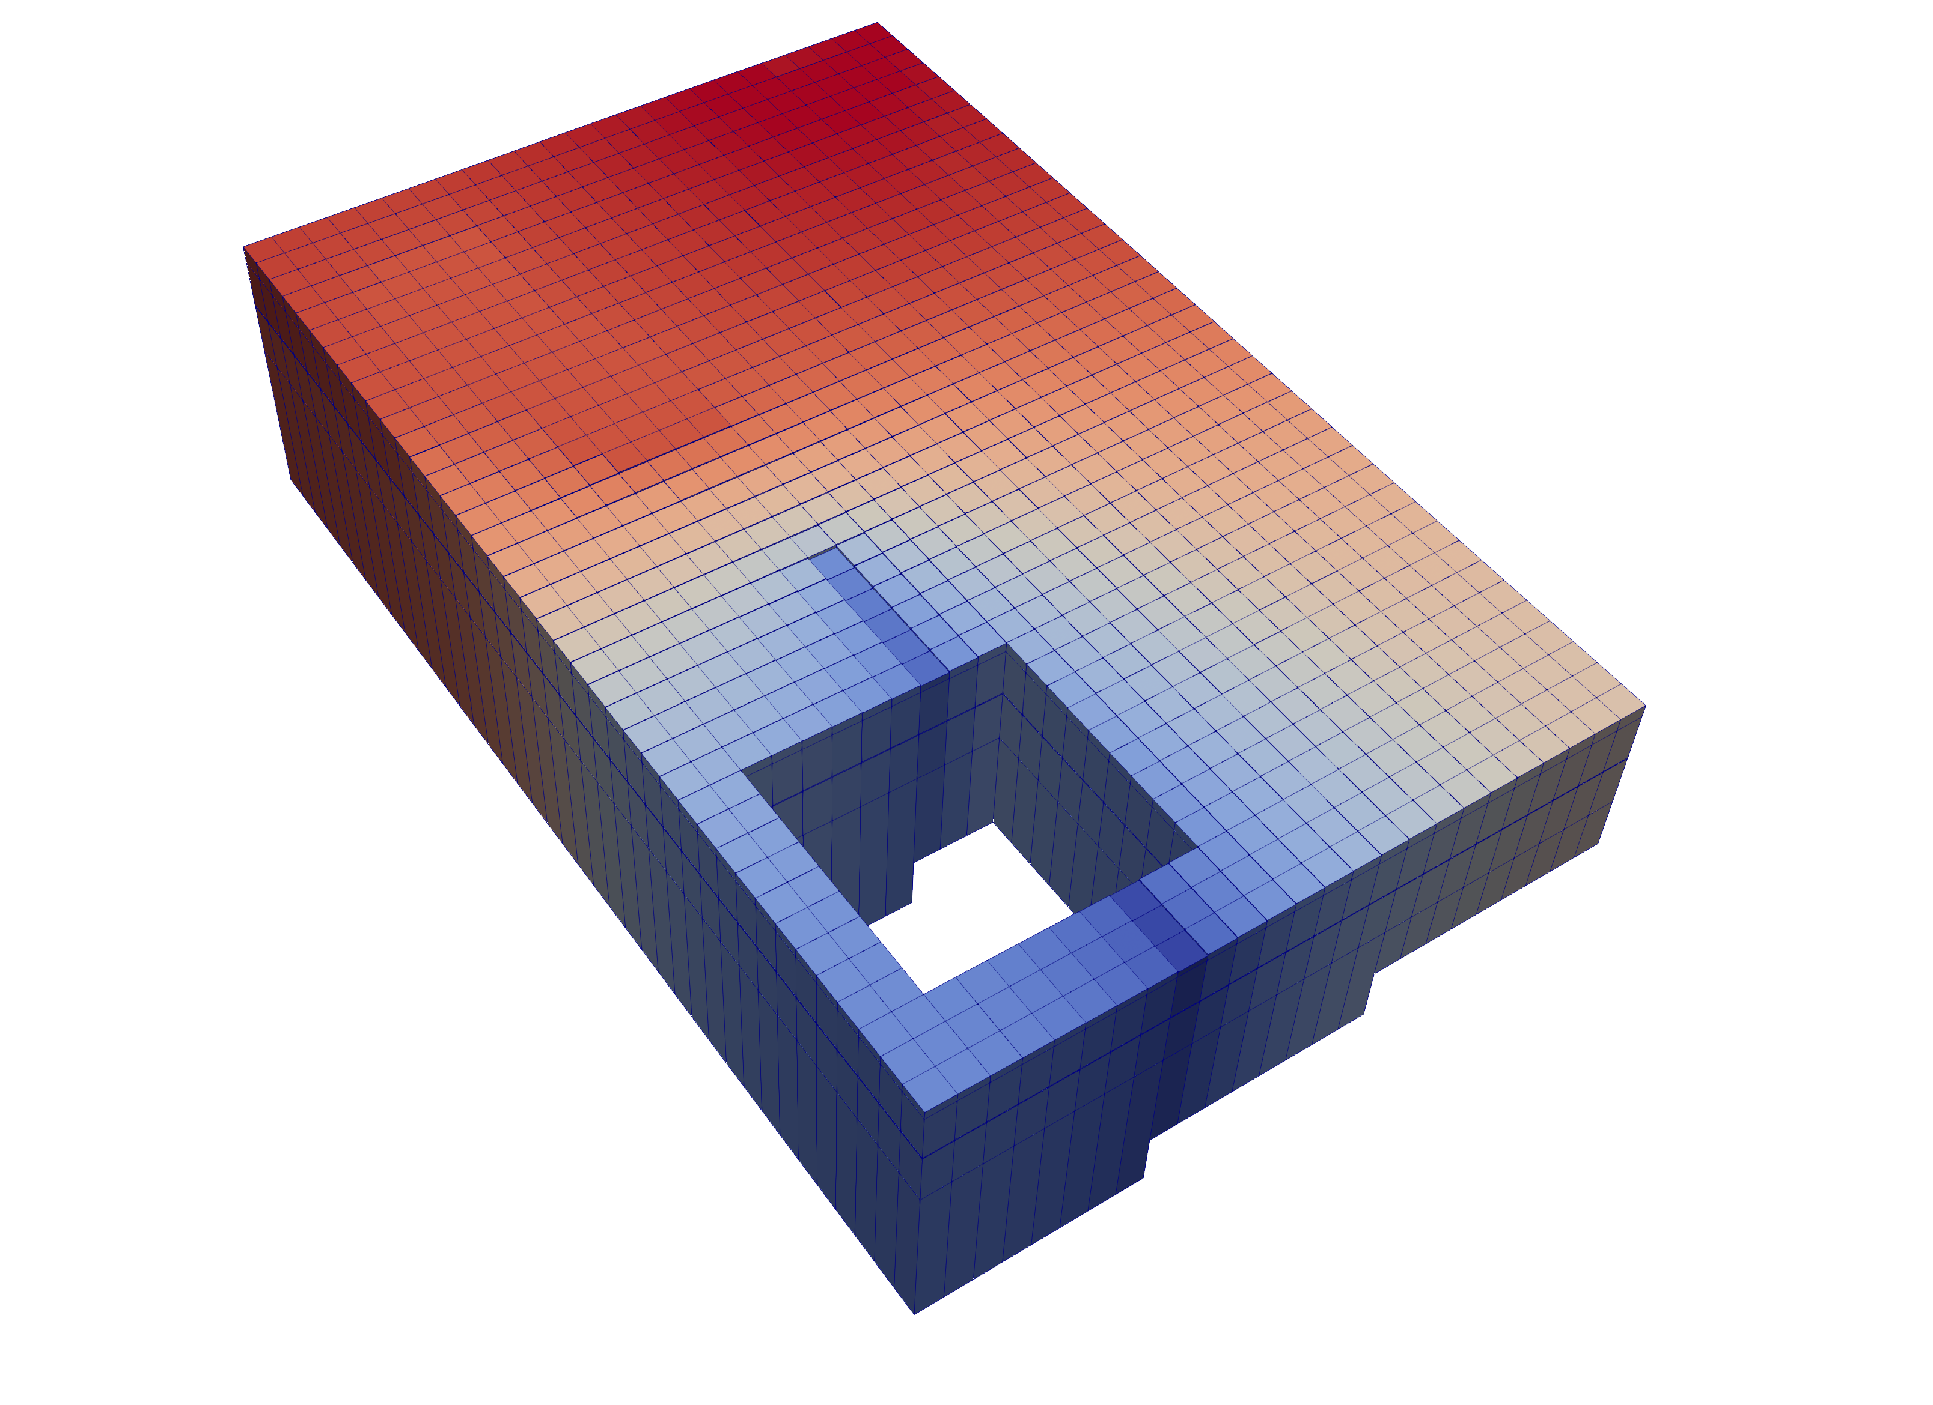
Multi-Model Coupling
Any number of models can be included in a simulation
Models coupled at matrix level
Flexibility supports coupling of parent, child, grandchild models, stacked models or adjacent models
Notes:
MODFLOW 6 consists of a "simulation"
Simulation can have any number of models in it
Multiple GWF Models, for example

Slide 5
Nested Grids
Parent
Child 1
Child 2
Grandchild

Slide 6
Multi-Level Grid Nesting
Notes:
Large scale and fine scale

Slide 7
MODFLOW 6 Framework Simulation Components
Simulation
Timing Module
Solutions
Models
Exchanges
Utilities
Timing Module
Solution 1
Model 1
Model 2
Model 3
Model 4
Exchange 1
Exchange 2
Exchange 3

Slide 8
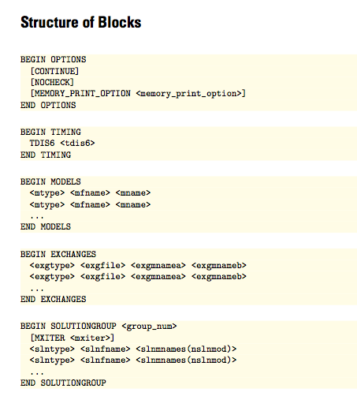
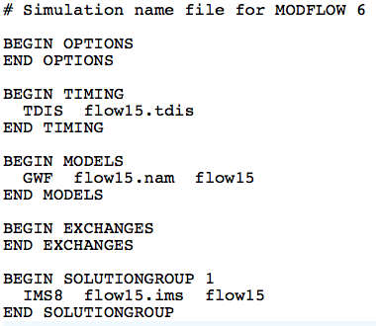
MODFLOW 6 Framework Simulation Name File
Required even for common case with one model
Named mfsim.nam
One simulation per folder

Slide 9
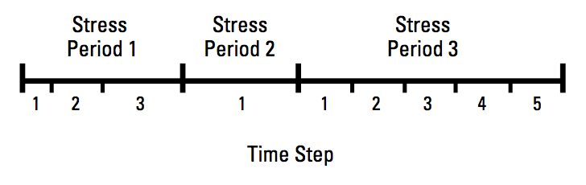
MODFLOW 6 Framework Timing Module
TDIS Package
Uses the MODFLOW concepts of stress periods, time steps
Alternative timing packages may be developed in the future
Timing applies to all models

Slide 10
MODFLOW 6 Framework Stress Period Data
BEGIN OPTIONS
PRINT_INPUT
PRINT_FLOWS
SAVE_FLOWS
END OPTIONS
BEGIN DIMENSIONS
MAXBOUND 42
END DIMENSIONS
BEGIN PERIOD 1
# canal
1 1 1 330.0
1 2 1 330.0
1 3 1 330.0
1 4 1 330.0
...
# river
1 1 20 320.0
1 2 20 320.0
1 3 20 320.0
...
END PERIOD
Stress are active until changed by the user
Different from previous MODFLOW versions
Can be specified using time series

Slide 11
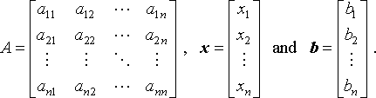
MODFLOW 6 Framework Solutions
Used to solve one or more models and exchanges
The only solution available now is the Iterative Model Solution, or IMS
Unstructured and asymmetric
IMS solves the following nonlinear equation
Ax = b

Slide 12
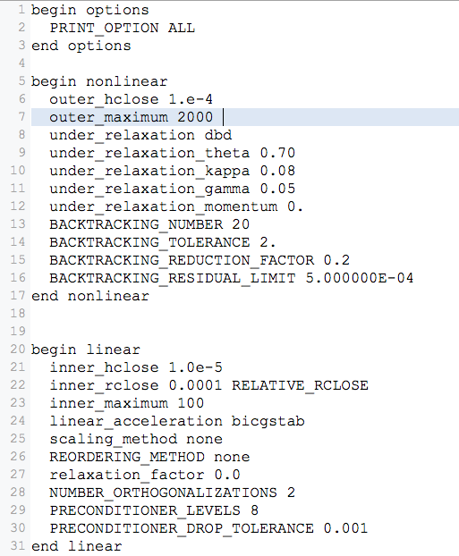
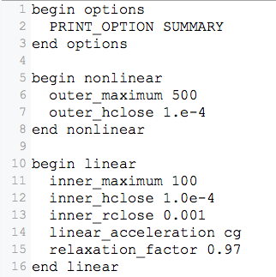
Iterative Model Solution (IMS6)

Slide 13
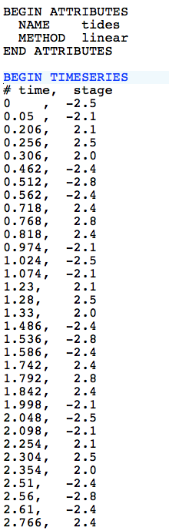
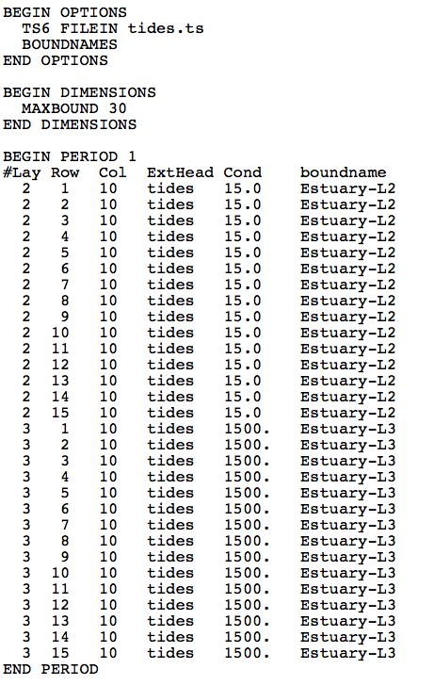
MODFLOW 6 Framework Time Series
tides.ts
GHB Input File

Slide 14
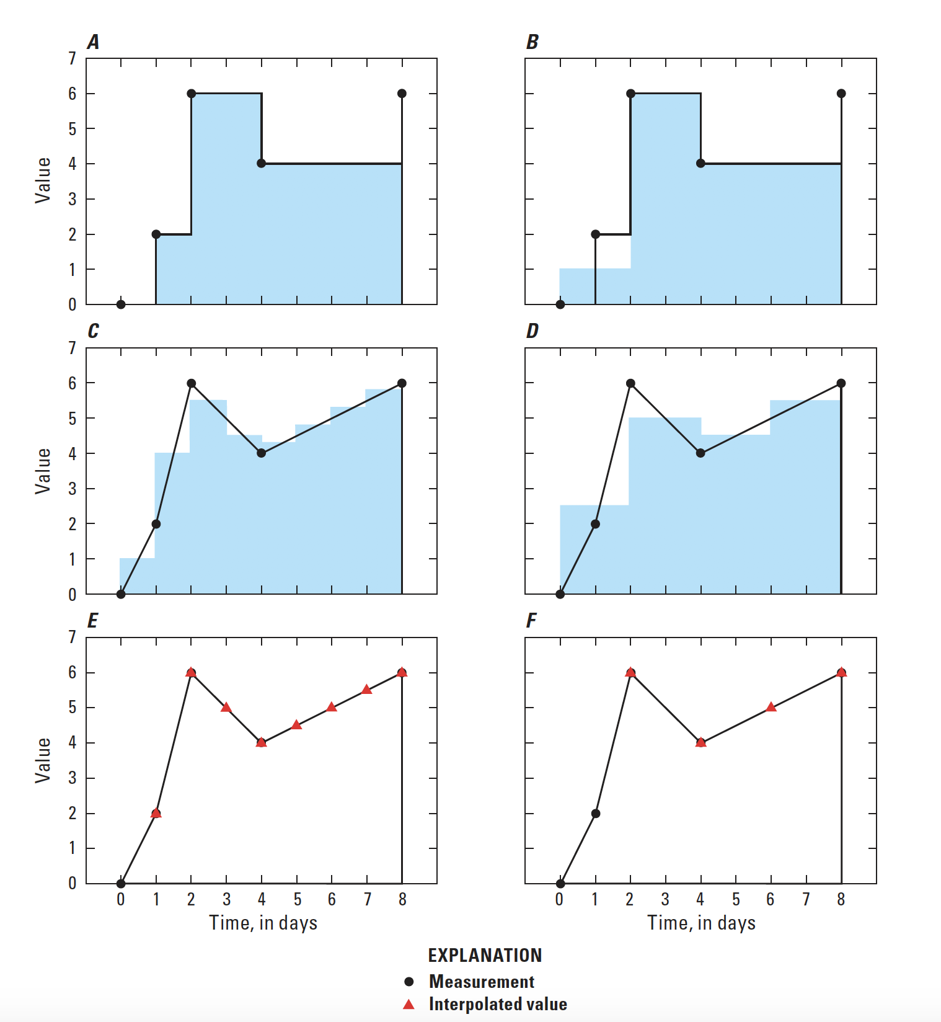
Timeseries Interpolation Methods
STEPWISE
Values are constant until changed
LINEAR
Average value is calculated for the time step
LINEAREND
Value interpolated at end of time step

Slide 15
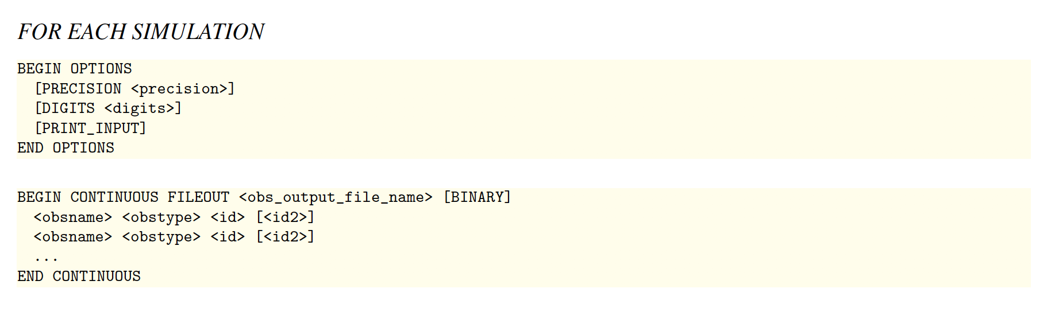
MODFLOW 6 Framework Observations
OBS Package for GWF Model
Heads
Flow between cells
Separate OBS files for each package

Slide 16
Groundwater flow (GWF) model

Slide 17
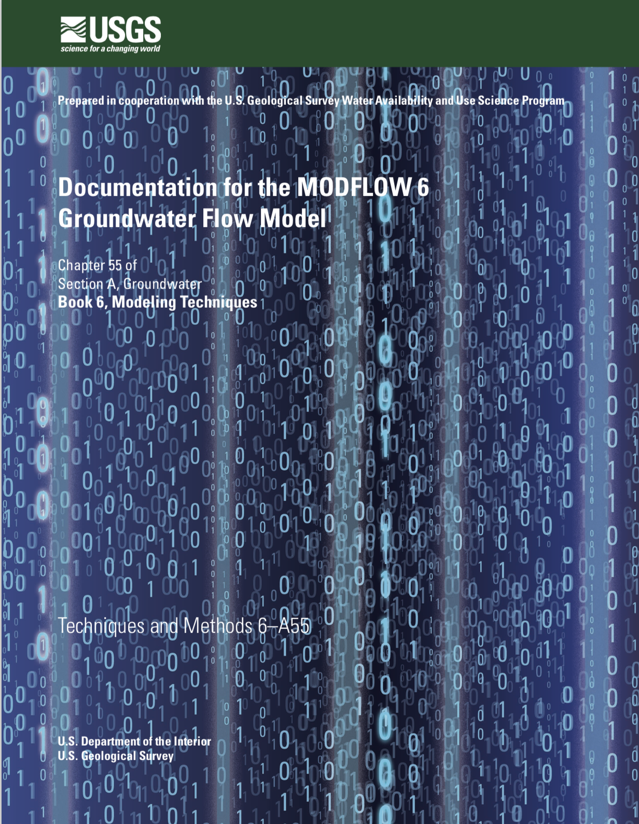
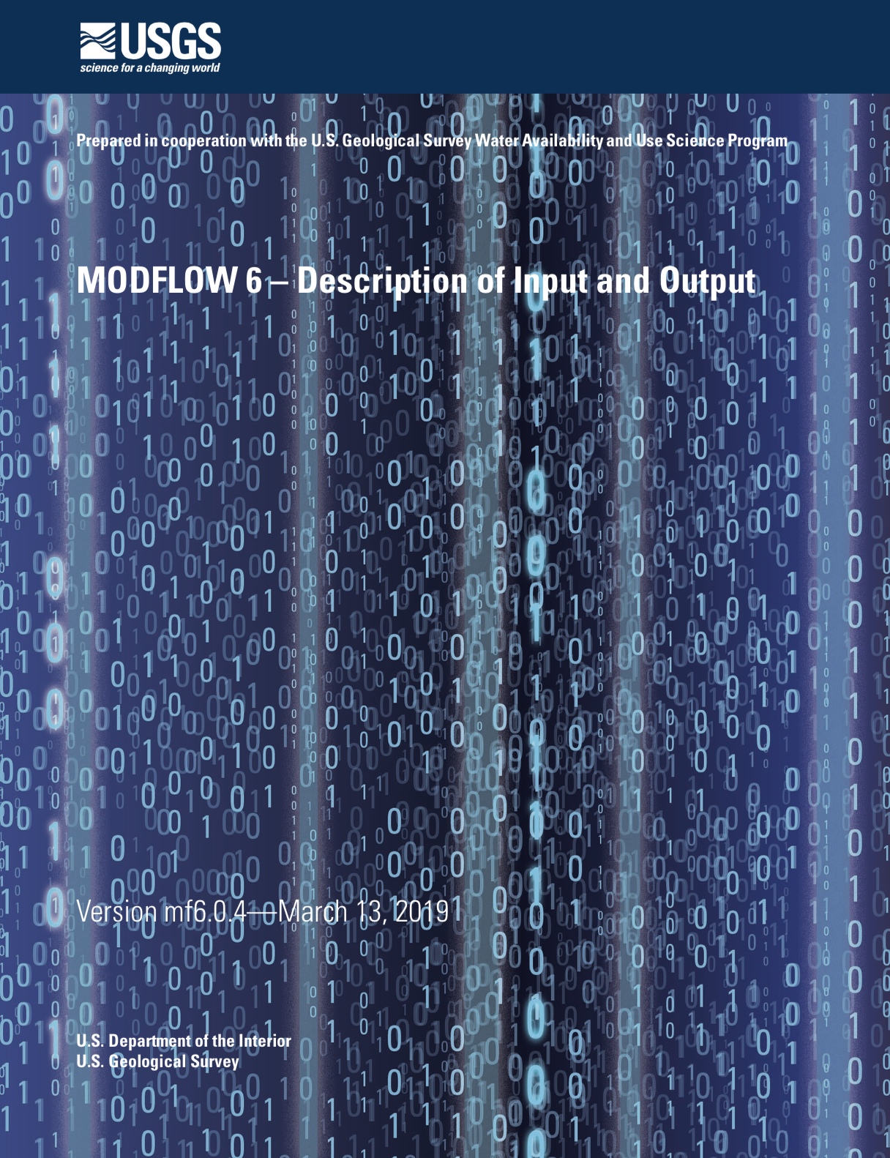
GWF Documentation

Slide 18
GWF Model Highlights
Generalized control-volume finite-difference formulation
Regular MODFLOW grids
Unstructured grids
IDOMAIN capability
Full 3D anisotropy
Multiple stress package ”instances”
Block and keyword input structure

Slide 19
UNDERLYING Formulation

Slide 20
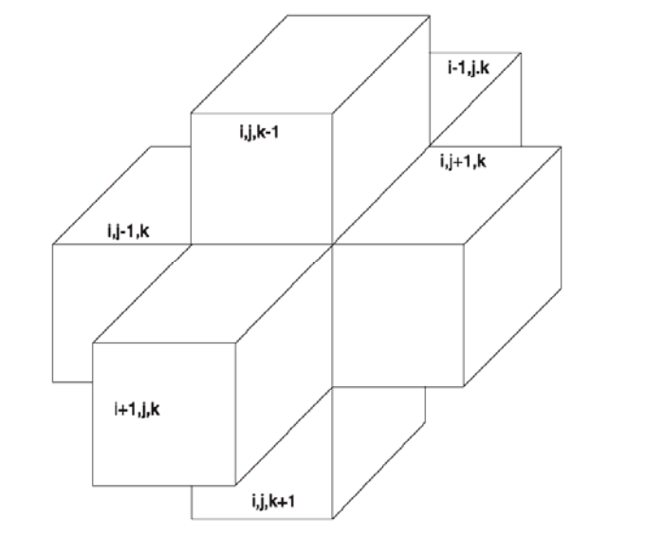
Finite-Difference Equation

Slide 21
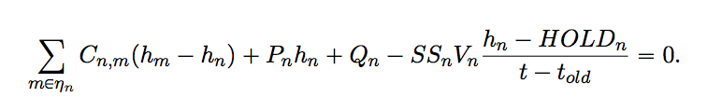
Generalized CVFD Equation

Slide 22
DISCRETIZATION

Slide 23
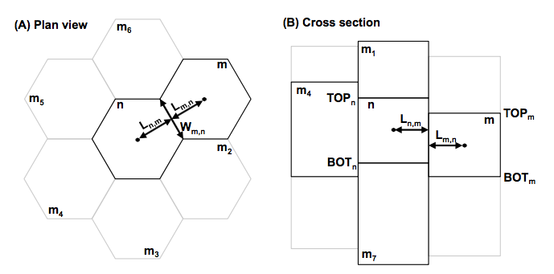
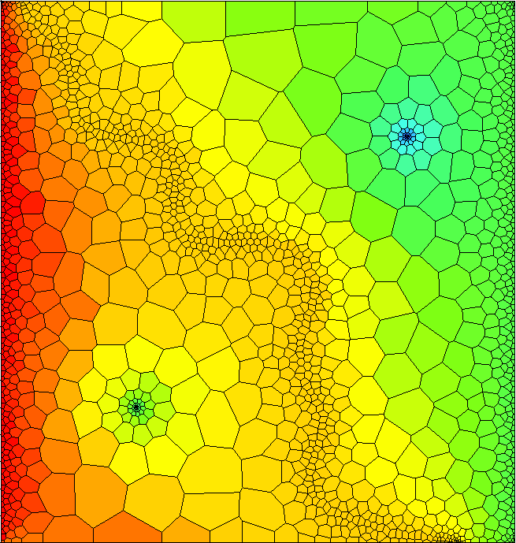
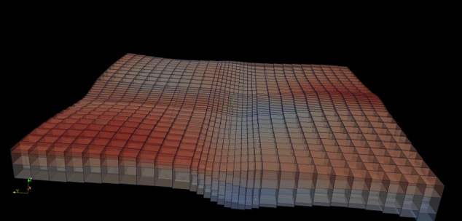
Spatial Discretization
Three ways to enter grid
DIS – regular MODFLOW grid
DISV – discretization by vertices
DISU – fully unstructured

Slide 24
Discretization (DIS) Package
“Regular MODFLOW grid”
Consists of layers, rows, and columns
Top and bottoms can have variable elevations

Slide 25
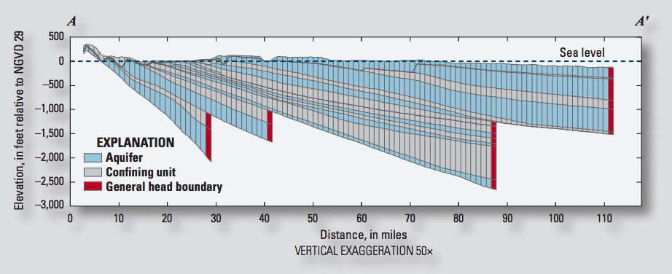
IDOMAIN Capability
Improve efficiency for models with large areas of inactive cells
Address MODFLOW limitations with discontinuous hydrogeologic layers

Slide 26
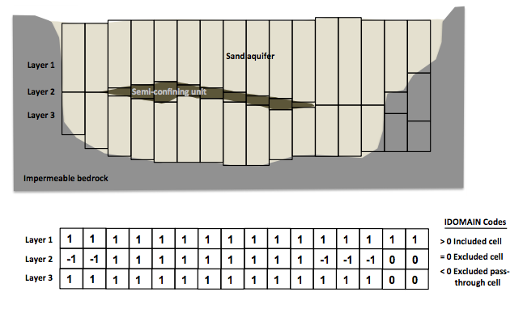
IDOMAIN Capability (cont.)
Permanently remove a cell from the simulation
Can be used with DIS and DISV
Optionally connect overlying and underlying cells

Slide 27
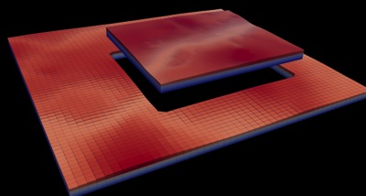
Multi-Model Simulation
MODFLOW 6 foundation allows models to be tightly coupled at the matrix level
Allows local grid refinement (LGR), and other model coupling strategies

Slide 28
LGR Simulation
Simulation
Temporal Discretization
PARENT
C1
C2
GC
Iterative Model Solution

Slide 29
GWF Exchanges
Simulation
Temporal Discretization
PARENT
C1
C2
GC
Iterative Model Solution
PARENT-C1
PARENT-C2
C1-GC

Slide 30
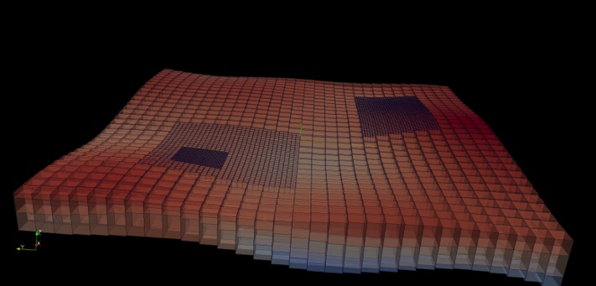
LGR Simulation
Simulation
Temporal Discretization
Simulation Name File
PARENT
BEGIN OPTIONS
END OPTIONS
BEGIN TIMING
TDIS6 mysim.tdis
END TIMING
BEGIN MODELS
GWF6 parent.nam PARENT
GWF6 c1.nam C1
GWF6 c2.nam C2
GWF6 gc.nam GC
END MODELS
BEGIN EXCHANGES
GWF6-GWF6 parent-c1.exg PARENT C1
GWF6-GWF6 parent-c2.exg PARENT C2
GWF6-GWF6 c1-gc.exg C1 GC
END EXCHANGES
BEGIN SOLUTIONGROUP 1
IMS6 mysolver.ims PARENT C1 C2 GC
END SOLUTIONGROUP
C1
C2
GC
Iterative Model Solution
PARENT-C1
PARENT-C2
C1-GC

Slide 31
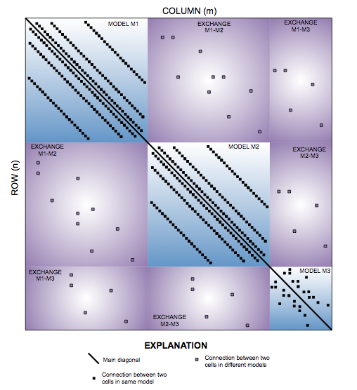
Matrix-Level Coupling
Simulation
Temporal Discretization
PARENT
C1
C2
GC
Iterative Model Solution
PARENT-C1
PARENT-C2
C1-GC
Notes:
Because our solver is unstructured and asymmetric, can handle Newton-Raphson, unstructured grids, ghost nodes, XT3D, dispersion tensors, etc…

Slide 32
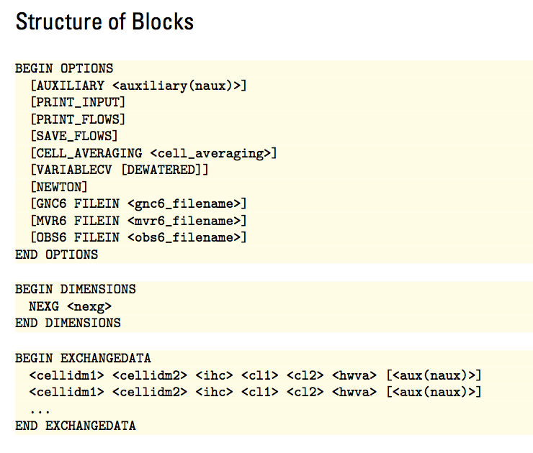
GWF6-GWF6 Exchange

Slide 33
NODE PROPERTY FLOW PACKAGE

Slide 34
Node Property Flow (NPF) Package
Primary purpose is to calculate conductance between adjacent cells
Confined or convertible cells (ICONVERT)
Homogeneous or heterogenous
Isotropic or anisotropic
Handles wetting and drying (REWET, WETDRY) (still available, but the Newton-Raphson method is much better)
Can calculate the three components of specific discharge at the cell center (SAVE_SPECIFIC_DISCHARGE). Nice for vector plots, and required for transport.

Slide 35
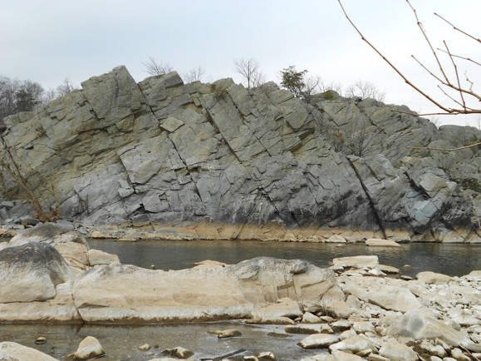
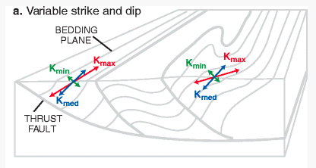
Representation of Anisotropy
Representation of full 3D anisotropy may be required for some problems (fractured aquifers, structurally deformed aquifers)
Some capabilities available (LVDA, SUTRA), but needed generalized CVFD method

Slide 36
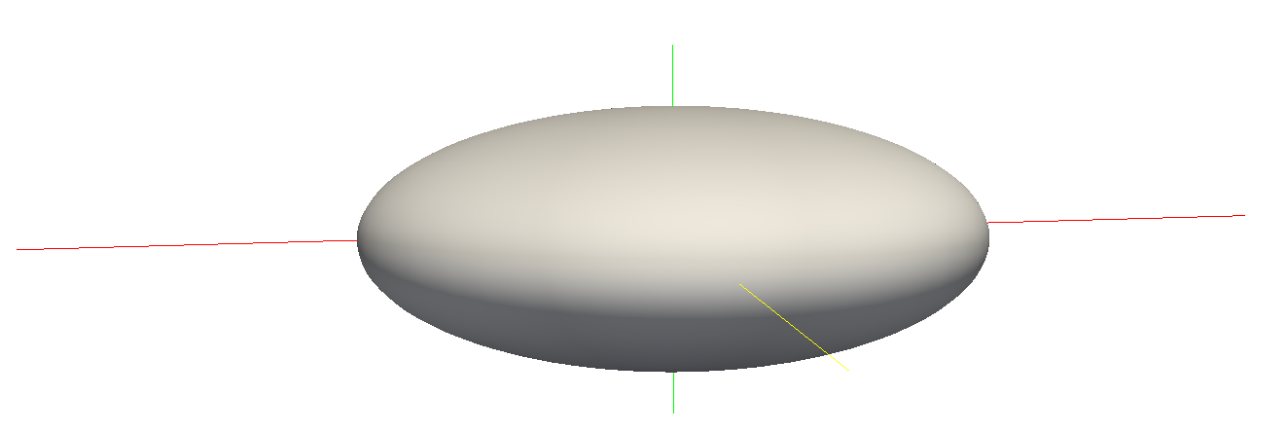
Hydraulic Conductivity Ellipsoid
Defined by three user-provided values on a cell by cell basis
For unrotated case,
K11 = Kx
K22 = Ky
K33 = Kz
K11
K22
K33

Slide 37
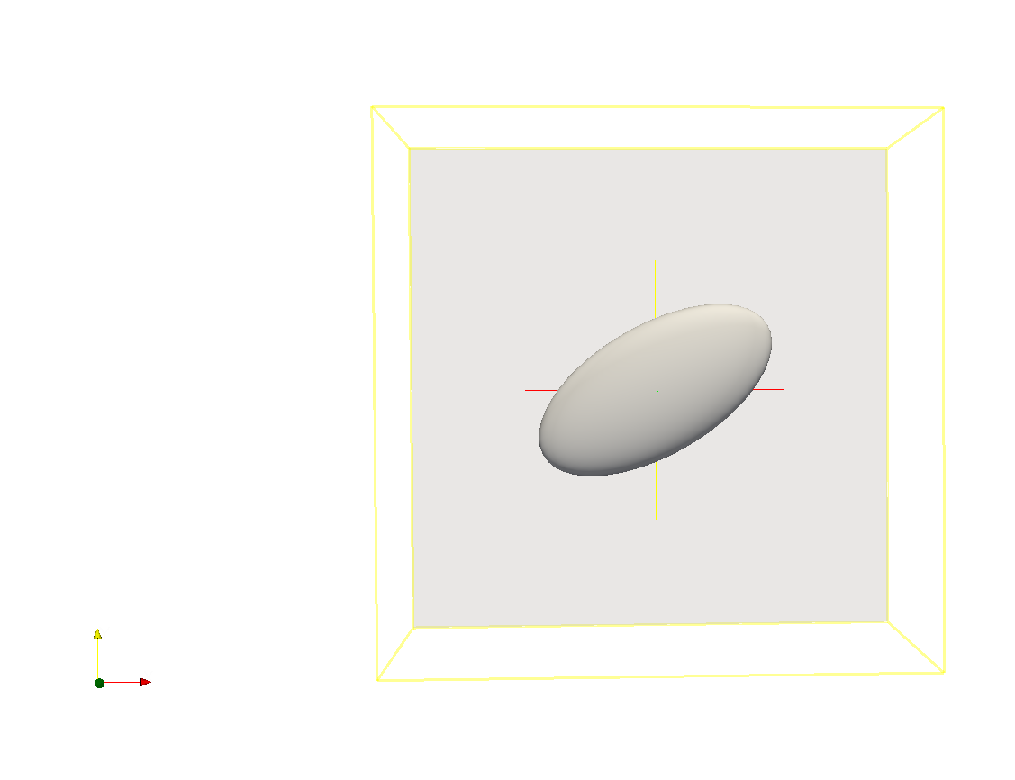
Ellipsoid Rotation
Users can optionally provide ANGLE1, ANGLE2, and ANGLE3 on a cell by cell basis
ANGLE1 is counter-clockwise rotation in the x, y plane

Slide 38
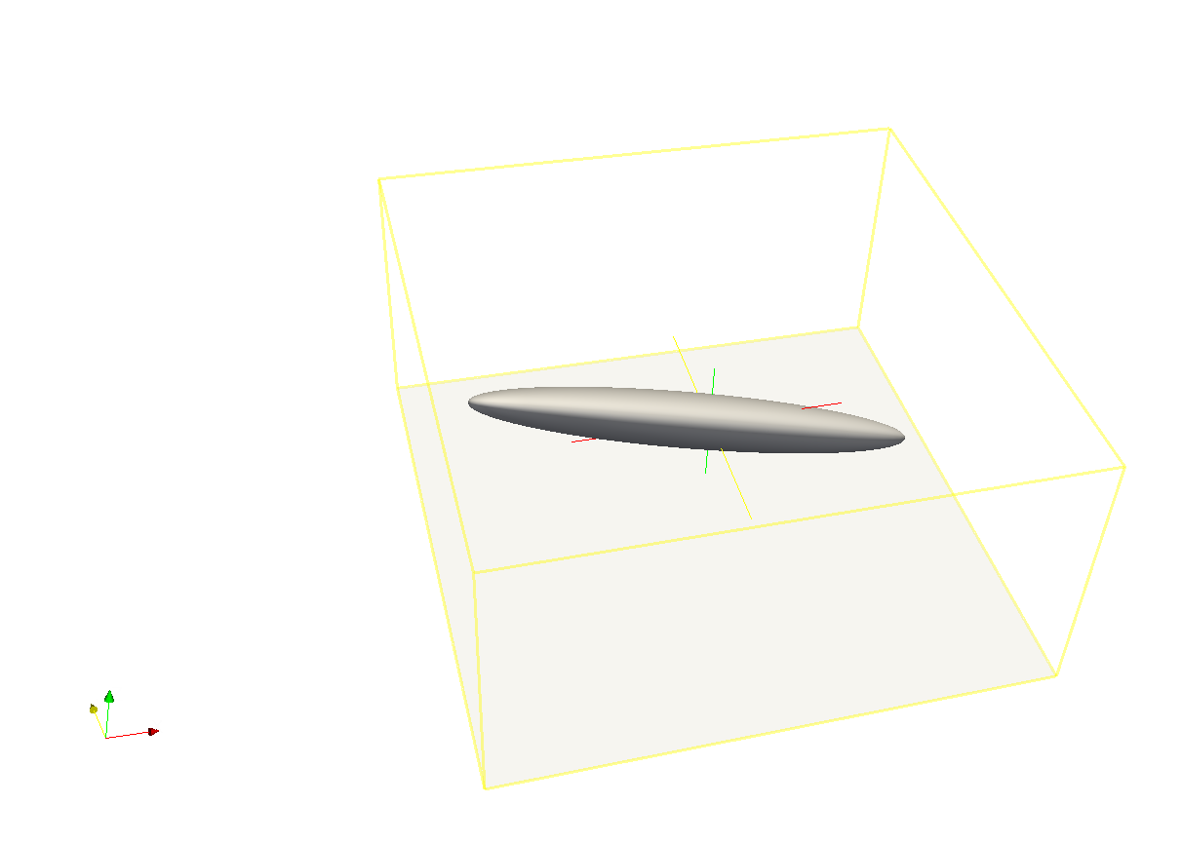
Ellipsoid Rotation (cont.)
All three angles can be specified to represent ellipsoid orientation

Slide 39
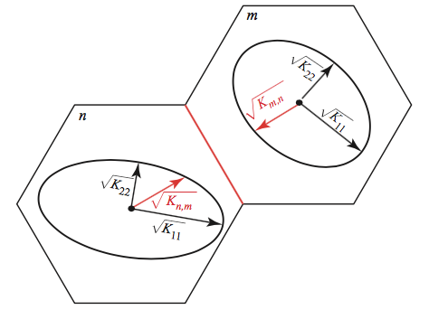
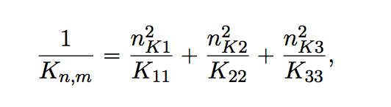
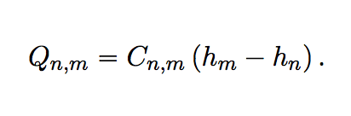
Effective Conductivity Approach
Large errors for certain ellipsoid configurations
Approximate, but relatively fast
Simple to implement

Slide 40
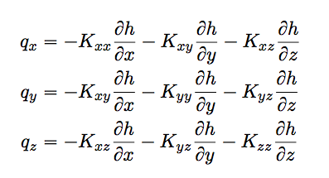
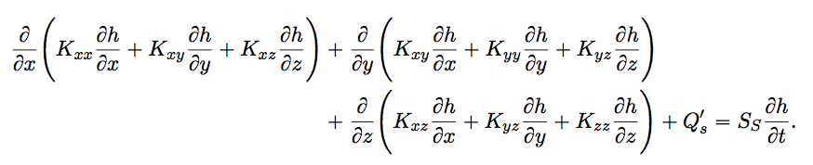
XT3D Approach
General and robust handling of anisotropy
Computationally expensive
Improves flow solution for certain grid types
More on this later

Slide 41
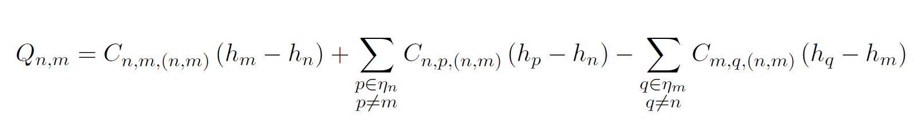
XT3D flow expression
Flow between two cells expressed in terms of conductance-like coefficients that can involve all neighbors of the two cells

Slide 42
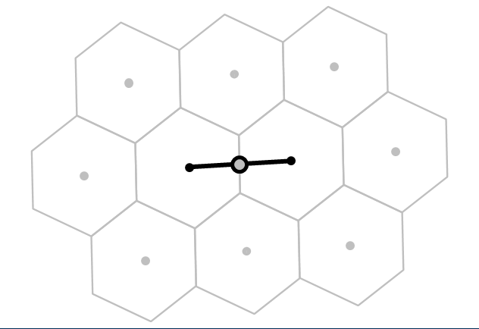
XT3D flow expression
Flow between two cells expressed in terms of conductance-like coefficients that can involve all neighbors of the two cells

Slide 43
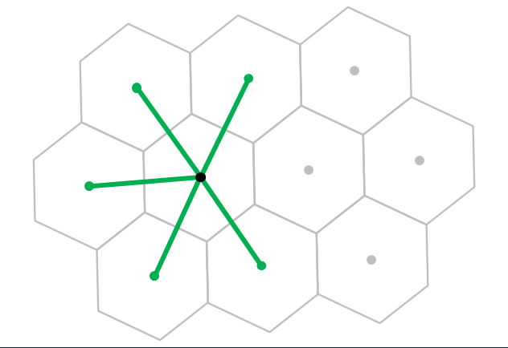
XT3D flow expression
Flow between two cells expressed in terms of conductance-like coefficients that can involve all neighbors of the two cells

Slide 44
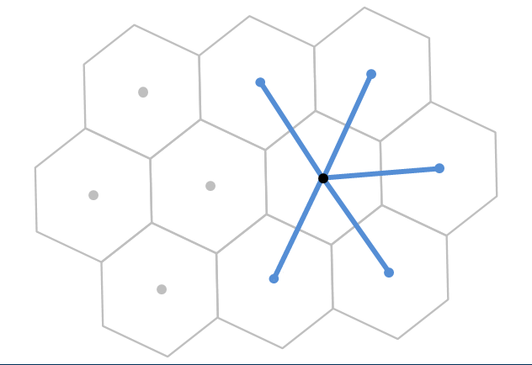
XT3D flow expression
Flow between two cells expressed in terms of conductance-like coefficients that can involve all neighbors of the two cells

Slide 45
XT3D flow expression
Flow between two cells expressed in terms of conductance-like coefficients that can involve all neighbors of the two cells
Larger stencil than in standard conductance-based MODFLOW formulation

Slide 46
XT3D performance
Longer run times than standard MODFLOW formulation
Requires more memory than standard MODFLOW formulation
“RHS” suboption makes memory requirement comparable to default formulation (same stencil)

Slide 47
Newton-Raphson Formulation

Slide 48
Formulation Issues
Originally developed for groundwater flow problems with standard boundary conditions to solve linear (confined) to well-behaved non-linear (unconfined) problems.
Empirical wetting and drying approach added by McDonald and others (1992) to allow cell conversion to simulate more difficult unconfined problems.
Three-dimensional unconfined applications and head-dependent stress packages can create additional nonlinearities.

Slide 49
Wetting/Drying Nonlinearities
Standard Formulation approach:
Dry cells are inactivated. This creates discontinuities and oscillations. Furthermore, wetting/drying results in varying stresses (for example, wells disappear from dry cells).
Newton-Raphson Formulation approach:
Keep all cells active even when the head in a cell is below the bottom of the cell

Slide 50
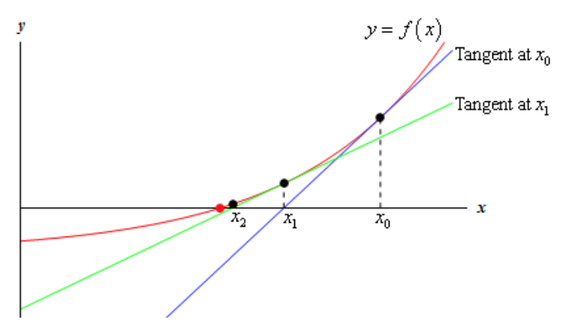
Newton-Raphson method
Standard Formulation:
Newton-Raphson:
Jacobian:
http://tutorial.math.lamar.edu/Classes/CalcI/NewtonsMethod.aspx
Modified Newton-Raphson:

Slide 51
Newton-Raphson Formulation
Conductance transitions from head-dependent to constant
0
Cell
bottom
Cell
top
Transition causes to change from 1 to zero, a discontinuous derivative

Slide 52
Newton-Raphson Formulation
Smooth saturated thickness function over the discontinuity.

Slide 53
Standard Formulation
dry
wet
h_{n} = 90
S_{Fn} = 0
BOT_{n} = 90
h_{m} = 95
S_{Fm} = 5
BOT_{m} = 90
Standard Formulation intercell conductance based on saturated thickness will prevent flow from a wet cell to a dry cell.

Slide 54
Newton-Raphson Formulation
dry
wet
h_{n} = 90
S_{Fn} = 0
BOT_{n} = 90
h_{m} = 95
S_{Fm} = 5
BOT_{m} = 90
Conductance is calculated based on saturated thickness of cell with higher head. Thus, there will be flow from the wet cell to the dry cell.

Slide 55
Newton-Raphson Formulation
Since cells remain active, simulated heads can be less than the cell bottom.

Slide 56
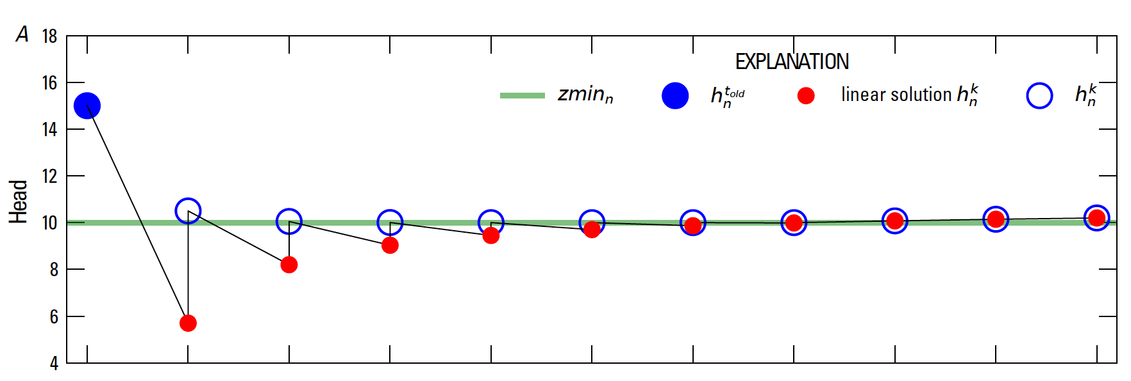
Newton-Raphson Formulation
Under-relaxation for Newton Solutions

Slide 57
Newton-Raphson Formulation
Once Newton-Raphson is enabled in the GWF name file Newton-Raphson is also used for GWF terms formulated by
Storage Package
Well Package (auto flow reduce)
Lake Package*
Multi-aquifer Well Package
Streamflow Routing Package*
Unsaturated Zone Flow Package*
* Stress package continuity equation also solved using Newton-Raphson

Slide 58
Newton-Raphson Formulation
Newton-Raphson formulation is more robust than Picard for strongly non-linear problems.
Newton-Raphson formulation results in a asymmetric matrix.
Asymmetric matrix requires different linear accelerators, line search methods, and under-relaxation methods

Slide 59
Iterative Model Solution (IMS6) Package
Nonlinear methods
Backtracking
Under-relaxation Methods
Simple (equivalent to MODFLOW-2005 PCG package under-relaxation)
Cooley
Delta-Bar-Delta
Pseudo-Transient Continuation for steady-state Newton-Raphson problems

Slide 60
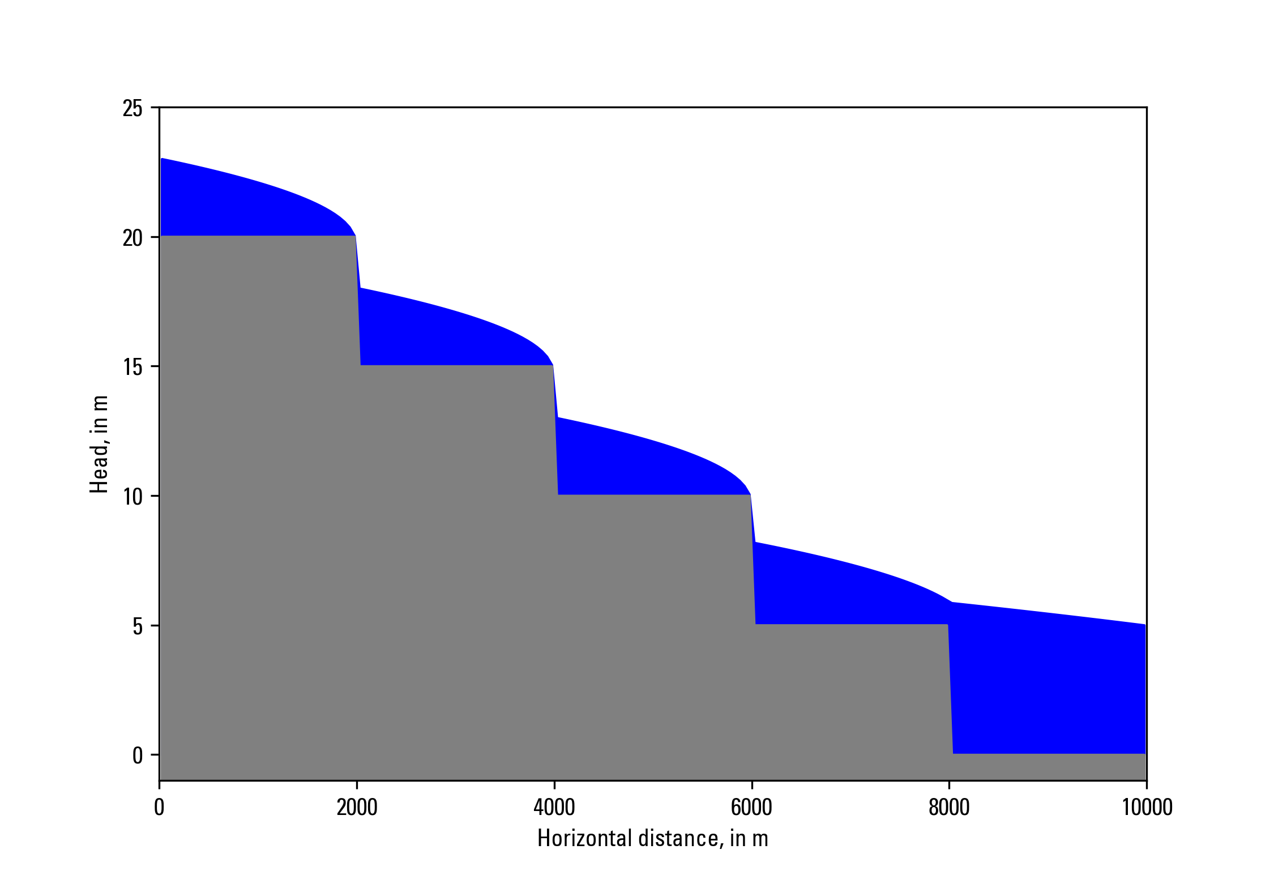
Newton-Raphson Formulation
Zaidel, Jacob, 2013, Discontinuous steady-state analytical solutions of the Boussinesq equation and their numerical representation by MODFLOW: Groundwater, v. 51, p. 952–959. doi: 10.1111/gwat.12019.

Slide 61
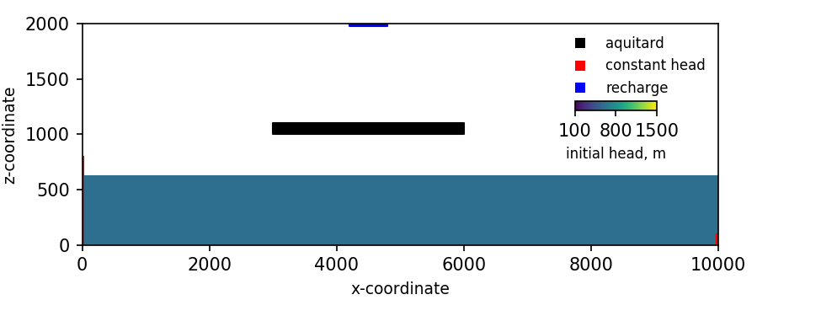
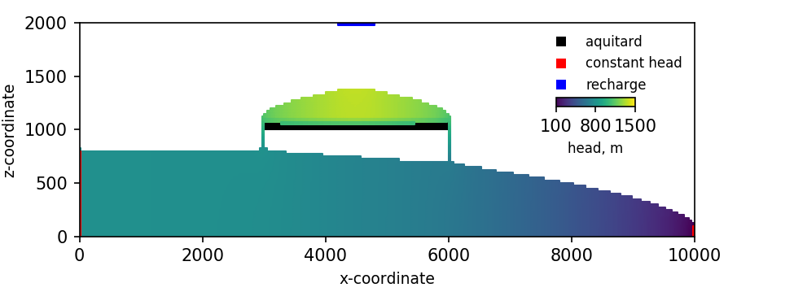
Newton-Raphson Formulation
Keating, Elizabeth, and Zyvoloski, George, 2009, A stable and efficient numerical algorithm for unconfined aquifer analysis: Ground Water, v. 47, no. 4, p. 569–579, accessed June 27, 2017, at https://doi.org/10.1111/ j.1745-6584.2009.00555.x.

Slide 62
storage

Slide 63
Storage (STO) Package
Steady state if STO Package not specified for a simulation
Cells are treated as confined or convertible (ICONVERT)
Aquifer storage properties (SS and SY) are specified
Individual stress periods are marked as steady state or transient

Slide 64
Skeletal Storage, Compaction and Subsidence (Csub) Package

Slide 65
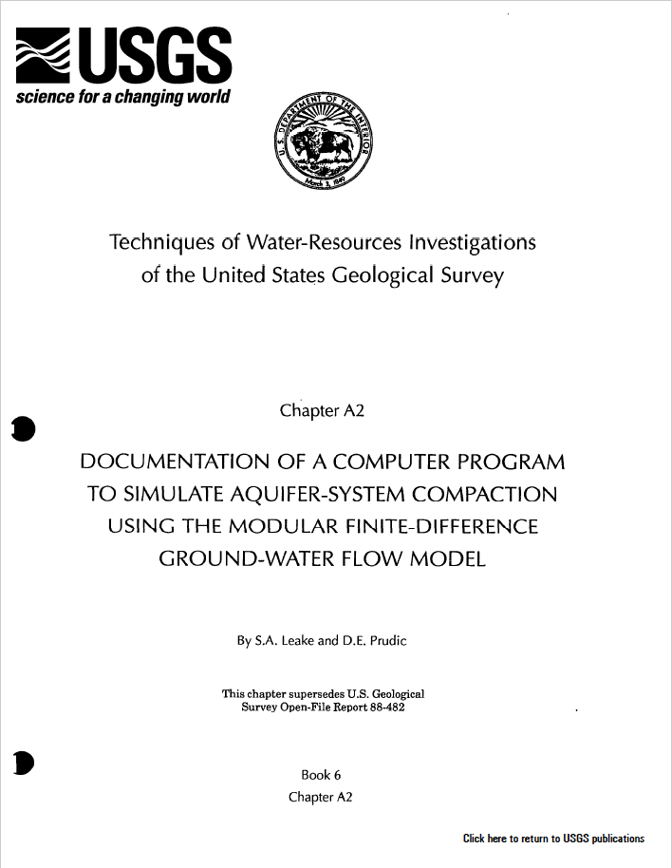
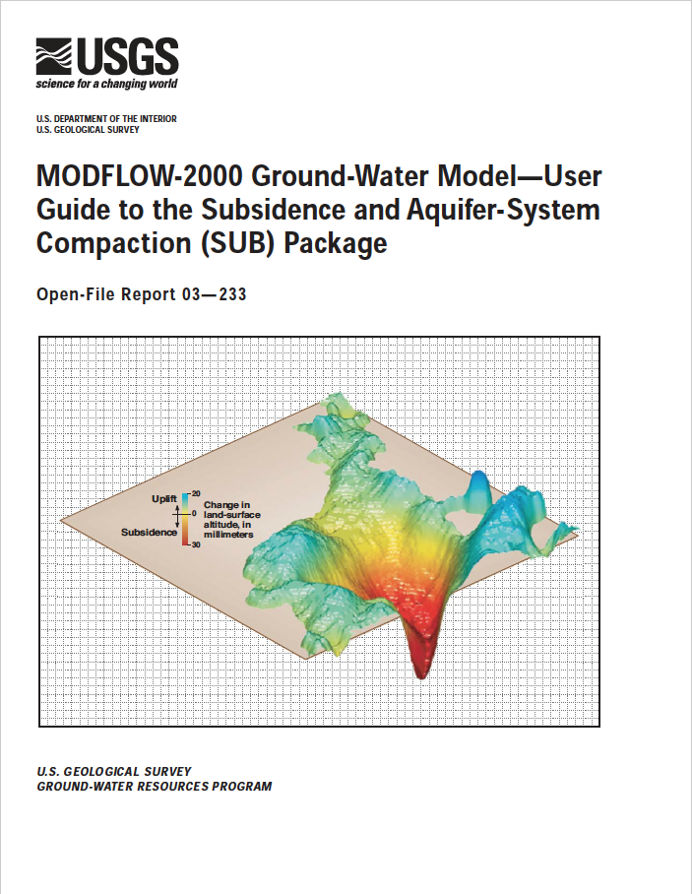
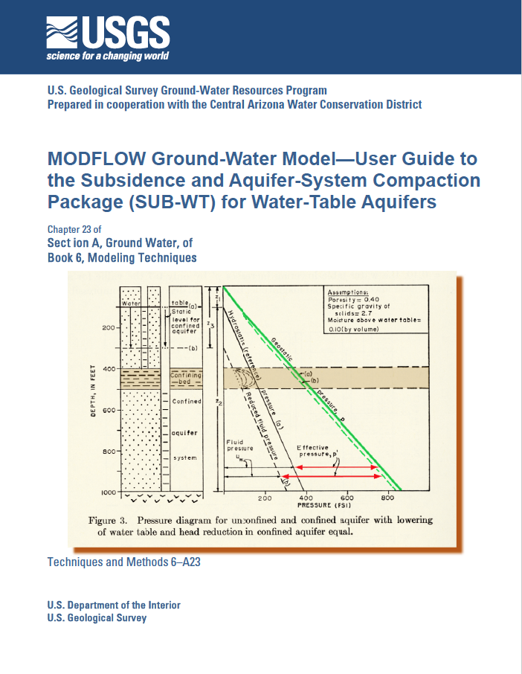
Previous subsidence package versions

Slide 66
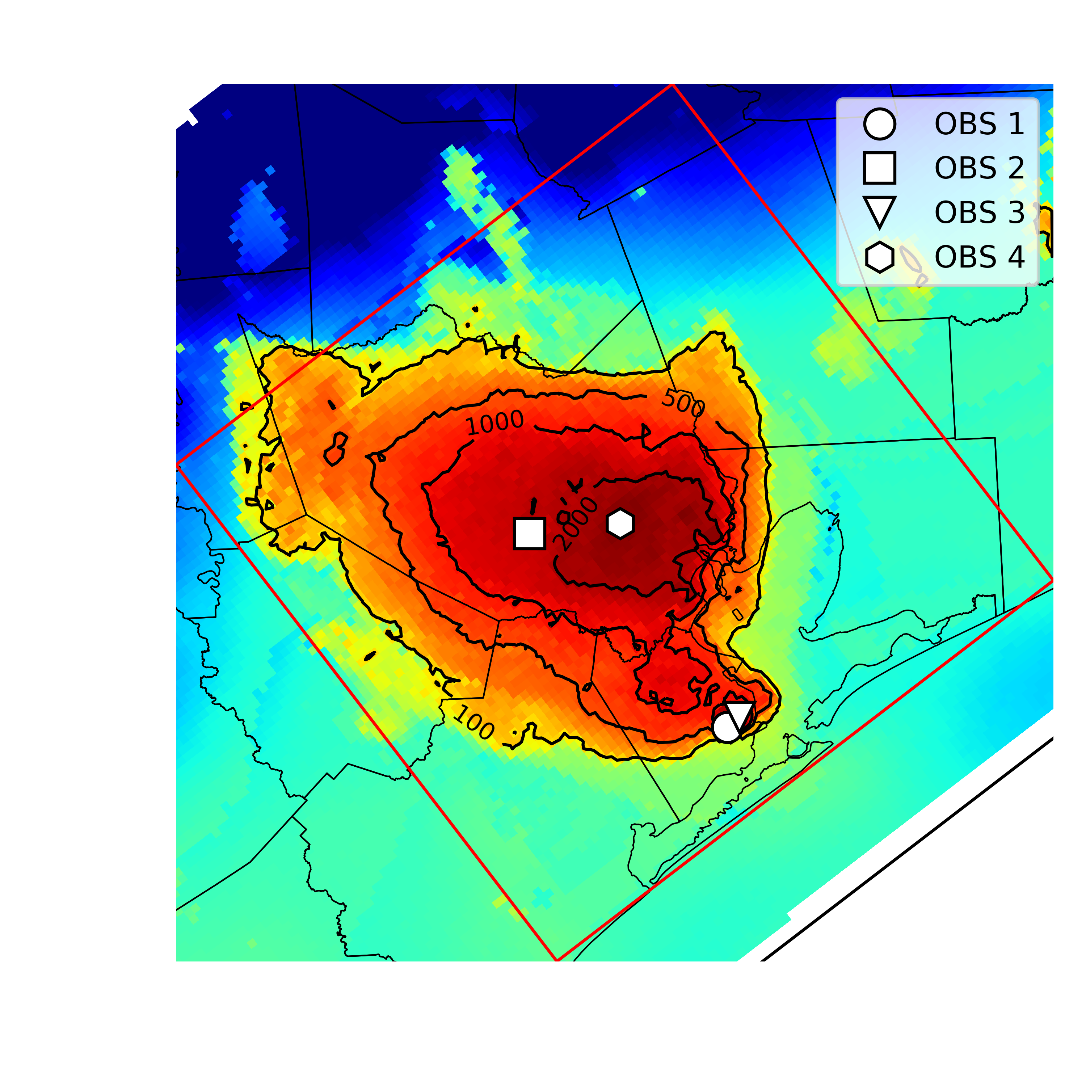
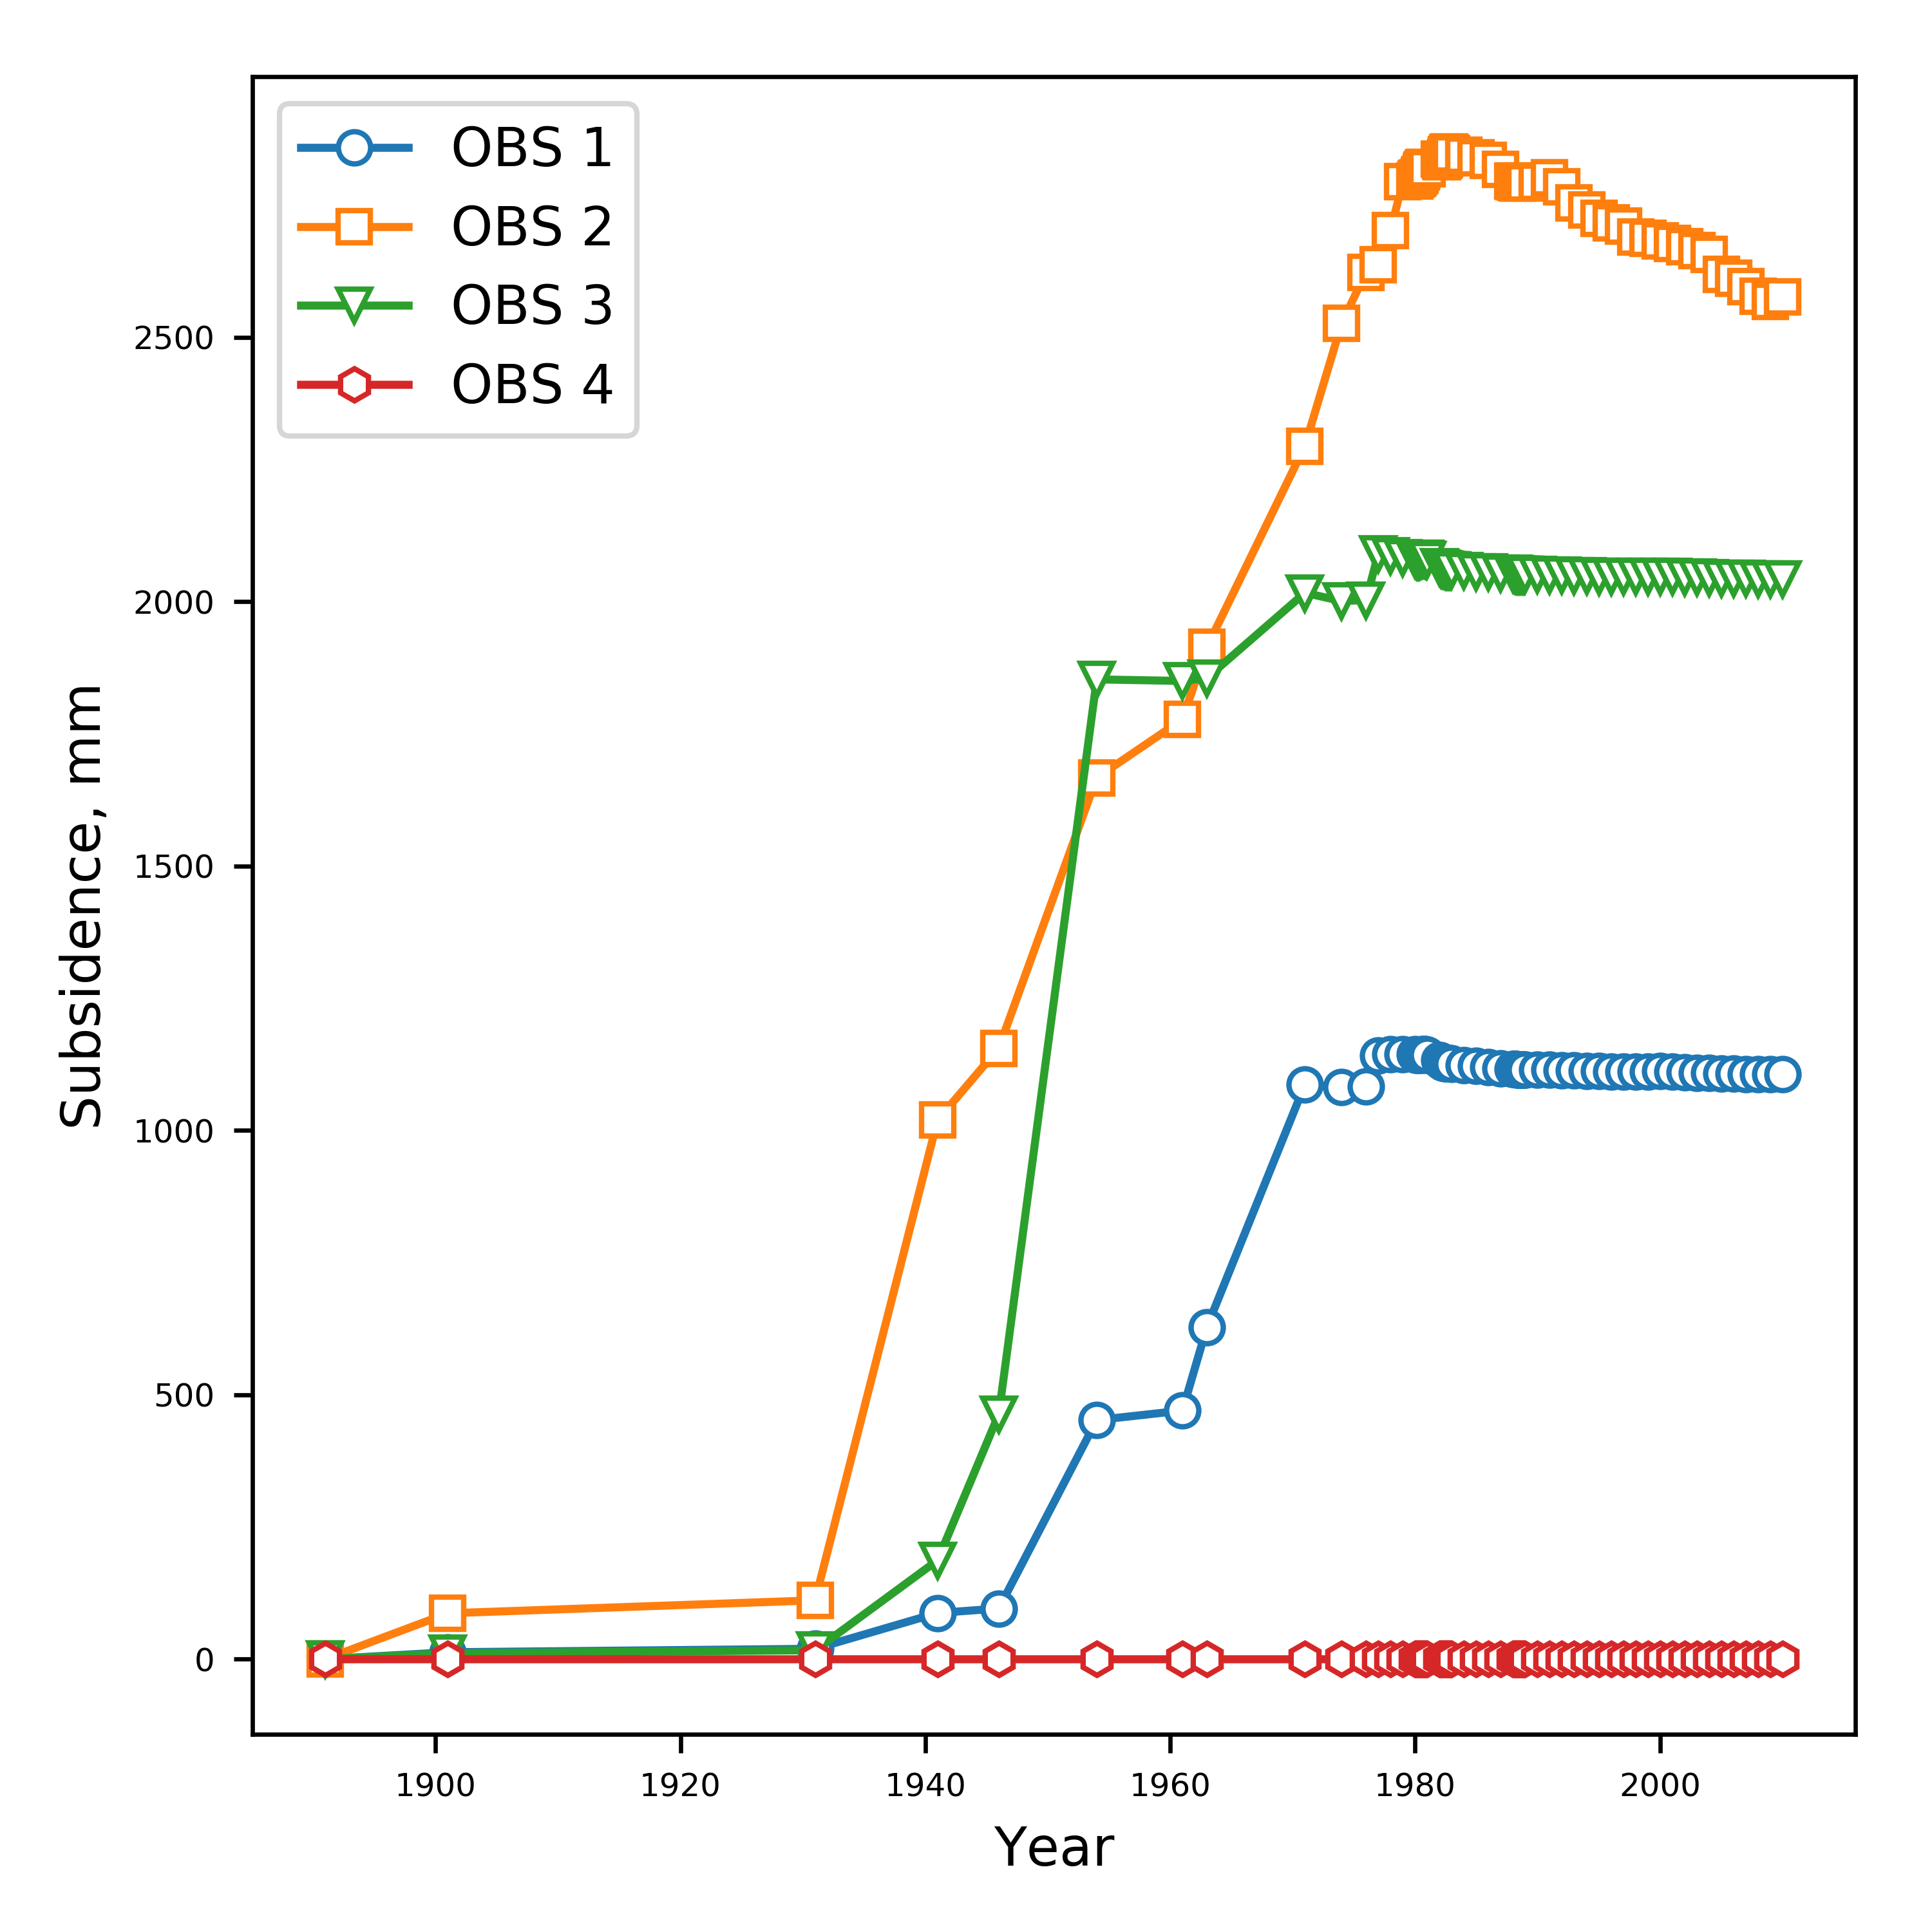
CSUB Package – Capabilities
Package based on MODFLOW-2005 SUB and SUB-WT Packages
Effective stress formulation
Effective stress dependent storage properties
Water table dependent compaction
Elastic and inelastic compaction of fine-grained sediments
No-delay (thin beds that equilibrate quickly)
Delay (thick beds that drain slowly – separate numerical solution)
Can account for elastic compaction of coarse-grained aquifer materials and water compressibility (full storage equation)

Slide 67
CSUB Package – theory
Assuming compaction is predominantly vertical
where

Slide 68
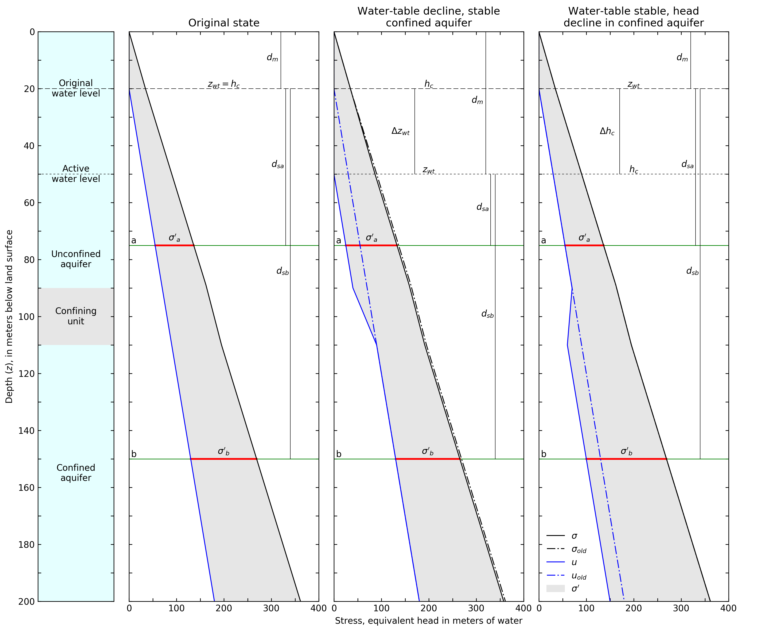
CSUB Package – theory

Slide 69

CSUB Package – input

Slide 70

CSUB Package – input options
Head-based formulation
Compaction dependent porosity/void ratio and thickness for no-delay beds
Specify interbed thickness as a fraction of cell thickness
Time-varying geostatic stress above model

Slide 71
One-dimensional column problem simulating extensometer observations
Sneed (2008) model used head-based formulation (SUB package)
Combination of no-delay and delay interbeds
Elastic compressibility of coarse-grained materials and water compressibility simulated
Specified water-levels used to simulate historic water-level changes
Calibrated using PEST++
Calibrated to simulated compaction from head-based results
Calibrated inelastic specific storage with tied elastic specific storage and original multiplier
Coarse-grained elastic specific storage insensitive

Slide 73
Traditional stress packages

Slide 74
Traditional Packages
Specified head (CHD) Package
No more IBOUND. Must use CHD
Can turn CHD cells on and off by stress period
Well (WEL) Package
Recharge (RCH) Package
Array-based or list based
River (RIV) Package
General-Head Boundary (GHB) Package
Drain (DRN) Package
Evapotranspiration (EVT) Package
Array-based or list based

Slide 75

All GWF Packages

Slide 76

Multiple Package of Same Type

Slide 77
QUESTIONS?

